Slide 1
CENT – Show Curve Clustering
August 16, 2017

Slide 2
Data
Data Row Length | 414,733
Aggregation | Episode level
Aggregated Data Row Length | 8224
Networks | Bravo, Syfy, USA, E!
Years | 2012 - 2017
Total Number of Shows | 277
Seasons in Subset | S1 & S2
Number of Shows in Subset | 50

Slide 3
Methodology
Data normalization through Discrete Cosine Transformation (DCT) for comparison
Use of different clustering algorithms:
K-Means
Principal Components Analysis (PCA)
Time Series Clustering:
Dynamic Time Warping (DTW)
K-Shape
TADpole
On different streams:
C3, LS
And different transformations:
Growth, Differences, Averages
And different normalization schemes:
S1 alone, S2 alone, S1 & S2 together, S1 & S2 appended
Selection of best clusters based on diagnostics:
Avg. Between, Avg. Within, W.B. Ratio, Widest Gap, Dunn Index, Silhouette Width, Within Cluster S.S.
Observe behavior of clusters in S2 through visualization, T-tests, and prediction improvement

Slide 4
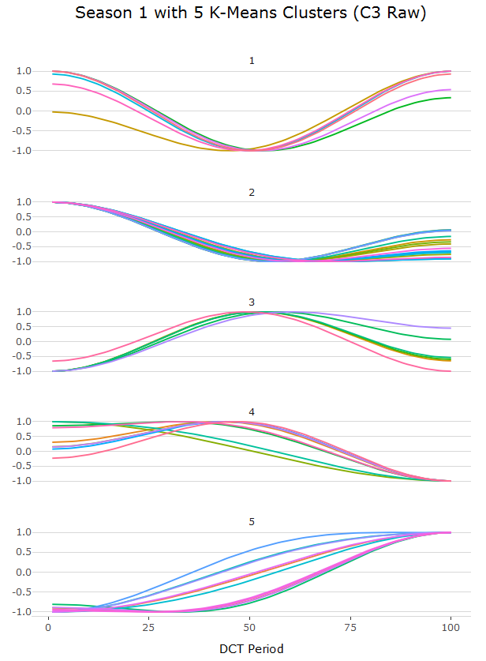
K-Means with 5 clusters performed best across almost all diagnostics, with curves suggesting 5 types of show trajectories.

Slide 5
Shows within clusters do not appear at first glance to be related by network or genre.
Cluster 1:
Burning Love
Expanse
Ladies of London
Satisfaction
Troy Street Magic
Z Nation
Total #: 6
Cluster 2:
12 Monkeys
Almighty Johnsons
Blood Sweat Heels
Botched Post Op
Christina Milian
Colony
Defiance
Dominion
Helix
Hollywood Medium
I am Cait
Magicians
Manzod with Children
Married to Jonas
Mr Robot
Odd Mom Out
Studio E
Total Divas
Total #: 18
Cluster 3:
Below Deck
Chrisley Knows Best
Ghost Mine
House of DVF
Killjoys
Newlyweds 1st Year
Peoples Couch
Royals
Sirens
Southern Charm
Thicker Than Water
Total #: 11
Cluster 4:
Bitten
Continuum
Dark Matter
Fashion Queens
Hello Ross
Married to Med ATL
Richkids of BH
Untying Knot
Wags
Total #: 9
Cluster 5:
Botched
Eric Jessie Game On
GGD
Graceland
Playing House
Vanderpump Rules
Total #: 6

Slide 6
Clusters generate groups with significantly different means on C3 impressions per episode.
Clustering Algorithm | Anova_pval_S1 | Anova_pval_S2
LS_raw_cluster | 0 | 0
LS_growth_cluster | 0 | 0
raw_growth_C3_cluster | 0.032 | 0
raw_growth_LS_cluster | 0.005 | 0
C3_LS_raw_cluster | 0 | 0
C3_LS_raw_diff_cluster | 0 | 0
C3_LS_raw_avg_cluster | 0 | 0
C3_LS_growth_cluster | 0.547 | 0
C3_LS_growth_diff_cluster | 0.010 | 0
C3_LS_growth_avg_cluster | 0.328 | 0
C3_RAW_kmeans_3 | 0.062 | 0
C3_RAW_kmeans_5 | 0 | 0
C3_RAW_kshape_2 | 0.263 | 0
C3_GROWTH_kmeans_4 | 0.173 | 0
C3_GROWTH_kmeans_5 | 0.002 | 0
C3_GROWTH_DTW_3 | 0.004 | 0
LS_RAW_DTW_3 | 0.106 | 0
LS_RAW_tadpole_5 | 0.001 | 0
LS_GROWTH_DTW_3 | 0 | 0.006
LS_GROWTH_tadpole_5 | 0 | 0

Slide 7
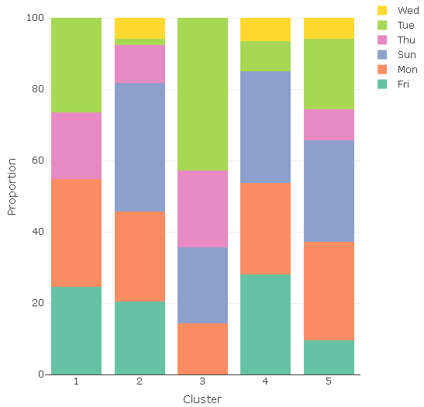
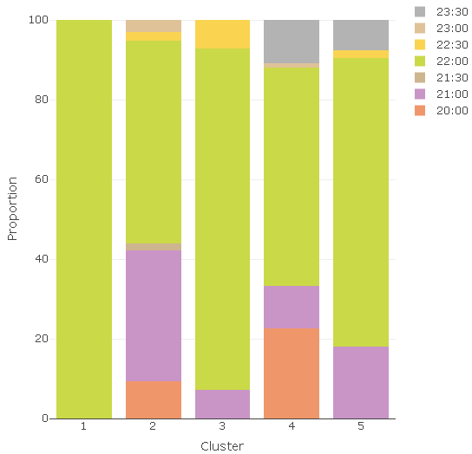
While cluster 1 contains only shows that begin at 10:00 PM, the clusters overall do not reflect uniqueness in schedule or other categorical variables.
Proportions of Days of Week in S1 C3 Raw Clusters
Proportions of Start Times in S1 C3 Raw Clusters

Slide 8
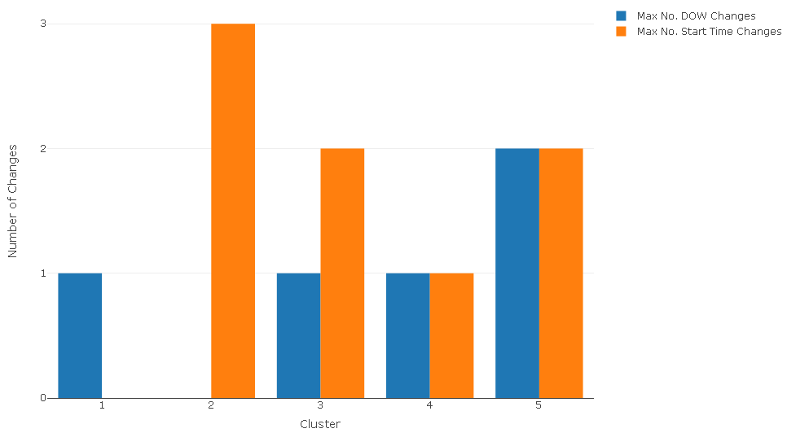
There are a couple of clusters in which the day of week or start time of shows within that cluster do not change in S1, but otherwise clusters do not reflect consistency in scheduling variables.
Number of DOW & Start Time Changes in S1 C3 Raw Clusters

Slide 9
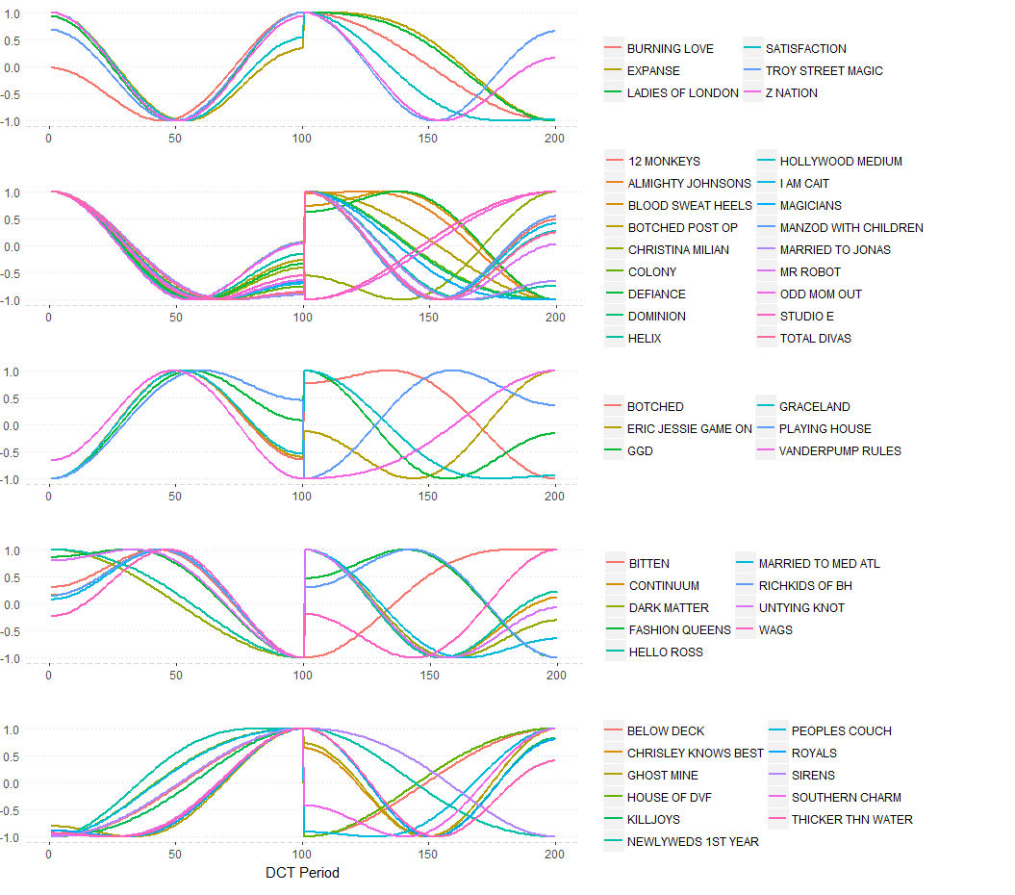
There are no clear patterns within the clusters in Season 2 trends.
S1 C3 Raw Clusters and S2 Trends
Shows in Cluster

Slide 10
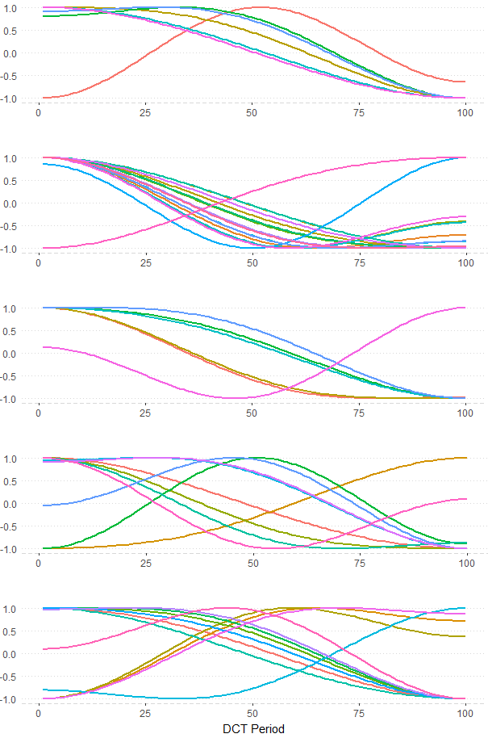
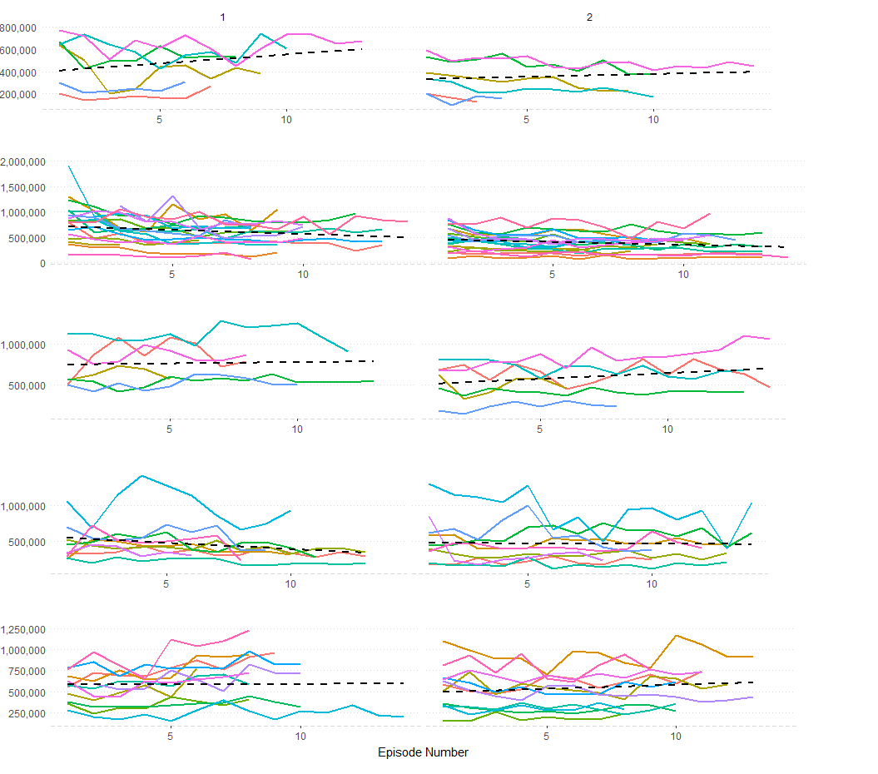
There are also few patterns within clusters of S1 to S2 normalized together, but cluster 2 seems to have a more distinct trend both as a normalized curve and in the raw data.
S1-S2 Normalized, Clustered on S1 C3 Raw
S1 & S2 Raw Trends, Clustered on S1 C3 Raw

Slide 11
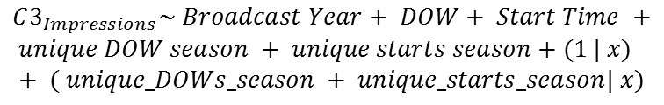

Including clusters may potentially improve prediction of mean Season 2 impressions.
Clustering Algorithm | Mape
Benchmark | 27.93427348
C3_RAW_kmeans_5 | 34.8191804
C3_GROWTH_kmeans_5 | 30.42767911
LS_raw_cluster (kmeans_5) | 30.20099404
LS_growth_cluster (kmeans_5) | 25.29373554
raw_growth_C3_cluster (kmeans_5) | 27.99856741
raw_growth_LS_cluster (kmeans_5) | 37.21103917
C3_LS_raw_cluster (kmeans_5) | 27.83643347
C3_LS_raw_diff_cluster (kmeans_5) | 13.18674301
C3_LS_raw_avg_cluster (kmeans_5) | 21.77044543
C3_LS_growth_cluster (kmeans_5) | 28.8257007
C3_LS_growth_diff_cluster (kmeans_5) | 27.09332053
C3_LS_growth_avg_cluster (kmeans_5) | 30.45262862
C3_RAW_kmeans_3 | 32.67501298
C3_RAW_kshape_2 | 32.40408287
C3_GROWTH_kmeans_4 | 25.93091412
C3_GROWTH_DTW_3 | 24.72164244
LS_RAW_DTW_3 | 40.72962699
LS_RAW_tadpole_5 | 15.13087901
LS_GROWTH_DTW_3 | 18.36262558
LS_GROWTH_tadpole_5 | 25.294778
Prediction Model:
$$C3_{Impressions}\sim Broadcast Year+ DOW+ Start Time +$$
$$unique DOW season + unique starts season+(1 | x)+ ( unique_DOWs_season + unique_starts_season| x)$$
Benchmark:
$$x=Show Name$$

Slide 12
Conclusions
Takeaway:
Shows can be clustered by normalizing impressions in Season 1 through DCT. Though at first glance these clusters seem to offer no information about Season 2 behavior, there seems to be statistical substantiation of the opposite being true. Further study is necessary to establish what exactly these clusters are grouping together.
Next Steps:
Integrate additional variables to clustering
Deepen understanding of clustering with additional metadata
Enhance predictive power of show-curve clusters
Test for clustering on splines

Slide 13
Appendix

Slide 14
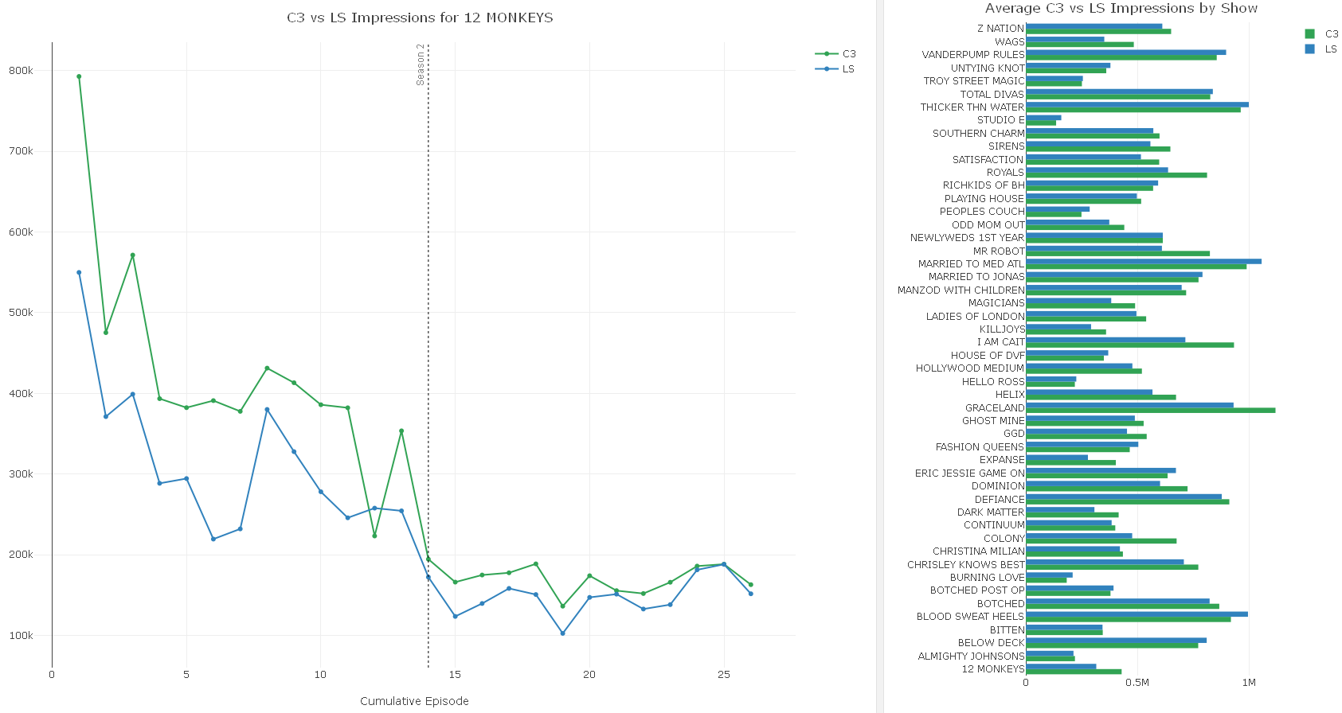
C3 vs LS

Slide 15
Diagnostics
name | average.between | average.within | wb.ratio | widestgap | dunn2 | avg.silwidth | within.cluster.ss | cluster.number | algorithm | season | stream | data
kmeans_C3_raw_s1_3cl | 11.7670037 | 4.03404047 | 0.342826481 | 4.185826883 | 2.510994573 | 0.583656629 | 574.4240912 | 3 | kmeans | s1 | C3 | raw
kmeans_C3_raw_s1_4cl | 11.36067884 | 3.426387718 | 0.301600615 | 3.58568336 | 2.097224187 | 0.578467105 | 397.9161094 | 4 | kmeans | s1 | C3 | raw
kmeans_C3_raw_s1_5cl | 10.80539794 | 2.573760669 | 0.238192123 | 3.292793097 | 1.876325191 | 0.557794841 | 258.6727872 | 5 | kmeans | s1 | C3 | raw
dtw_C3_raw_s1_3cl | 11.76302592 | 3.963699804 | 0.336962601 | 4.185826883 | 2.27529496 | 0.585968024 | 576.6152316 | 3 | DTW | s1 | C3 | raw
kshape_C3_raw_s1_2cl | 12.10532746 | 6.2168152 | 0.513560267 | 4.185826883 | 1.908391694 | 0.469132949 | 1292.585303 | 2 | kshape | s1 | C3 | raw
pca_C3_raw_s1_3cl | 11.57714946 | 4.318953927 | 0.373058493 | 4.185826883 | 1.766105988 | 0.534513868 | 701.4706591 | 3 | PCA | s1 | C3 | raw
tadpole_C3_raw_s1_3cl | 11.77563592 | 4.718238093 | 0.400677987 | 4.185826883 | 2.201875077 | 0.534349099 | 705.2855652 | 3 | TADpole | s1 | C3 | raw
tadpole_C3_raw_s1_5cl | 10.51662241 | 2.879198351 | 0.273775956 | 3.292793097 | 1.209842389 | 0.503685843 | 319.9352336 | 5 | TADpole | s1 | C3 | raw
kmeans_C3_growth_s1_3cl | 10.91603792 | 4.272696985 | 0.391414634 | 5.008263672 | 1.723267937 | 0.512969382 | 658.1610366 | 3 | kmeans | s1 | C3 | growth
kmeans_C3_growth_s1_4cl | 10.76422224 | 3.224718059 | 0.299577432 | 2.680985952 | 2.34374678 | 0.572098447 | 338.2442955 | 4 | kmeans | s1 | C3 | growth
kmeans_C3_growth_s1_5cl | 10.06443107 | 2.759778199 | 0.274211049 | 2.680985952 | 1.226895284 | 0.523738625 | 253.9587731 | 5 | kmeans | s1 | C3 | growth
dtw_C3_growth_s1_3cl | 11.12768126 | 5.106886788 | 0.458935394 | 3.904312791 | 1.796955912 | 0.469267236 | 778.409799 | 3 | DTW | s1 | C3 | growth
kshape_C3_growth_s1_5cl | 9.97809394 | 5.380335089 | 0.539214716 | 11.42985456 | 0.676550446 | 0.322240449 | 877.6482109 | 5 | kshape | s1 | C3 | growth
pca_C3_growth_s1_3cl | 10.94085486 | 4.729431559 | 0.43227258 | 5.008263672 | 1.619178986 | 0.454947846 | 748.8787402 | 3 | PCA | s1 | C3 | growth
tadpole_C3_growth_s1_3cl | 10.91603792 | 4.272696985 | 0.391414634 | 5.008263672 | 1.723267937 | 0.512969382 | 658.1610366 | 3 | TADpole | s1 | C3 | growth
tadpole_C3_growth_s1_5cl | 10.19769293 | 3.962838778 | 0.388601501 | 5.008263672 | 1.247632688 | 0.345162165 | 497.2928237 | 5 | TADpole | s1 | C3 | growth
stream | data | season | largest_between | smallest_within | smallest_wb_ratio | smallest_gap | largest_dunn2 | largest_sil | smallest_ss | best
C3 | raw | s1 | 2 kshape | 5 kmeans | 5 kmeans | 5 kmeans | 3 kmeans | 3 DTW | 5 kmeans | 5 kmeans
C3 | growth | s1 | 3 DTW | 5 kmeans | 5 kmeans | 4 kmeans | 4 kmeans | 4 kmeans | 5 kmeans | c("4 kmeans", "5 kmeans")
C3 | raw+growth | s1 | 4 kmeans | 5 kmeans | 5 kmeans | 3 TADpole | 5 kmeans | 5 kmeans | 5 kmeans | 5 kmeans
LS | raw | s1 | 3 kmeans | 5 kmeans | 5 kmeans | 3 kmeans | 4 kmeans | 5 kmeans | 5 kmeans | 5 kmeans
LS | growth | s1 | 3 DTW | 5 kmeans | 5 kmeans | 4 kmeans | 3 DTW | 5 kmeans | 5 kmeans | 5 kmeans
LS | raw+growth | s1 | 3 TADpole | 5 kmeans | 5 kmeans | 5 kmeans | 5 kmeans | 5 kmeans | 5 kmeans | 5 kmeans
C3+LS | raw | s1 | 3 kmeans | 5 kmeans | 5 kmeans | 3 kmeans | 3 kmeans | 3 kmeans | 5 kmeans | 3 kmeans
C3+LS | growth | s1 | 2 DTW | 5 kmeans | 5 kmeans | 4 kmeans | 4 kmeans | 4 kmeans | 5 kmeans | c("4 kmeans", "5 kmeans")
C3+LS | raw avg | s1 | 3 kmeans | 5 kmeans | 5 kmeans | 3 kmeans | 3 kmeans | 3 kmeans | 5 kmeans | 3 kmeans
C3+LS | raw diff | s1 | 3 DTW | 5 kmeans | 5 kmeans | 5 kmeans | 3 DTW | 5 kmeans | 5 kmeans | 5 kmeans
C3+LS | growth avg | s1 | 3 TADpole | 5 kmeans | 5 kmeans | 4 kmeans | 5 kmeans | 5 kmeans | 5 kmeans | 5 kmeans
C3+LS | growth diff | s1 | 3 TADpole | 5 kmeans | 5 kmeans | 4 kmeans | 4 kmeans | 4 DTW | 5 kmeans | 5 kmeans

Slide 16
See dashboards and HTML files for other materials.

